Slide 1
Let’s Make the Invisible VISIBLE
What’s in clean air?

Slide 2
Hi! I’m Professor Airianna
WELCOME TO THE ALBERTA AIRSHEDS COUNCIL’S VIRTUAL CLASS TO LEARN ABOUT HOW HUMAN ACTIONS CAN AFFECT WEATHER AND CLIMATE.

Slide 3
Over the next 20 minutes...
Students will learn how we impact air quality and how air quality impacts our health. We will also learn how air quality relates to climate change and identify actions we can take to reduce air pollution.

Slide 4
Here’s what you’ll do
1 – Learn about weather, climate and air quality
2 – Read “Be Air Aware”
3 – Watch this 1-minute video to learn about Alberta’s Airsheds
4 – Complete a fun experiment over the next 2 weeks (5 minutes per day)
5 – Submit your results to the Alberta Airsheds Council for a chance to win!

Slide 5
Here’s what you’ll need Index card (or sturdy paper) Petroleum jelly String and/or paperclips Popsicle stick Pencil, ruler Magnifying glass

Slide 6
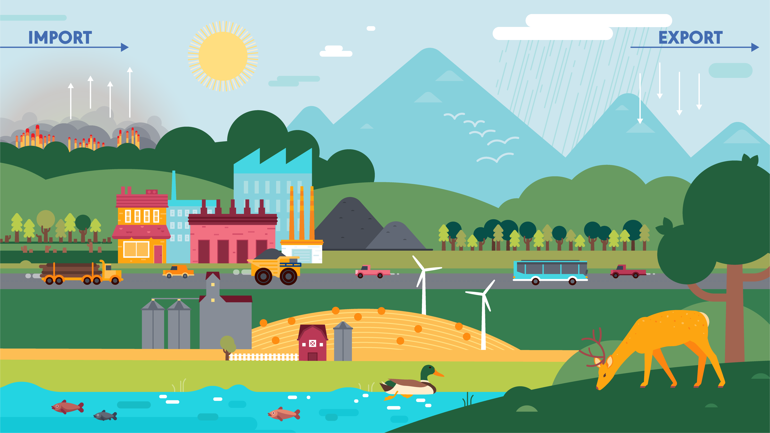
READY? Let’s begin!

Slide 7
Weather: the state of the air and atmosphere at a particular time and place. Climate: the average condition of the weather at a place over a particular time as shown by temperature, wind velocity, and precipitation.

Slide 8
Air Quality: the degree to which the air is pollution-free, assessed by measuring a number of indicators of pollution.

Slide 9
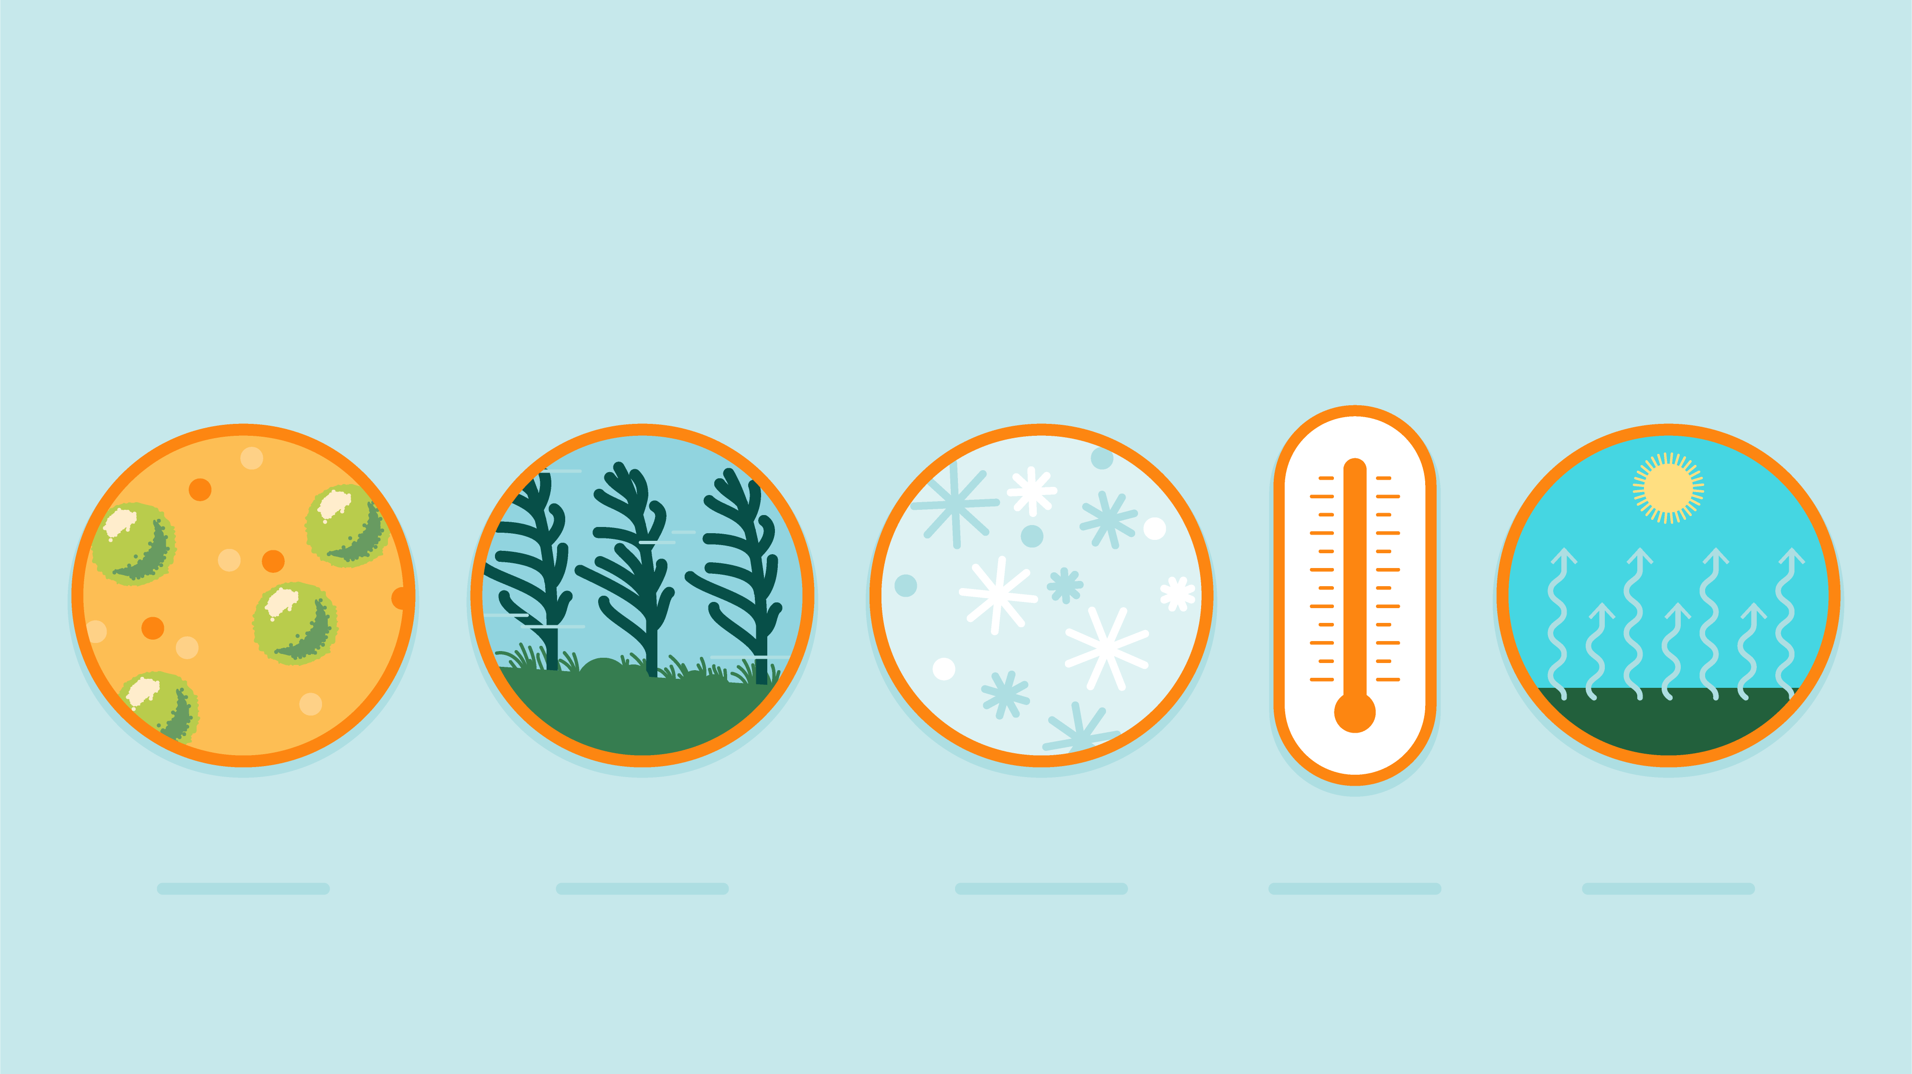
Weather affects air quality.

Slide 10
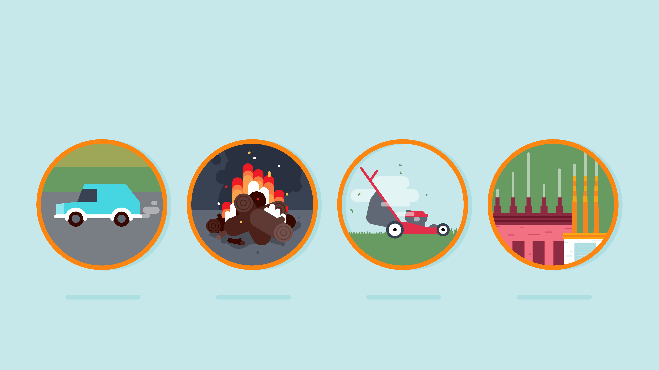
We affect air quality.

Slide 11
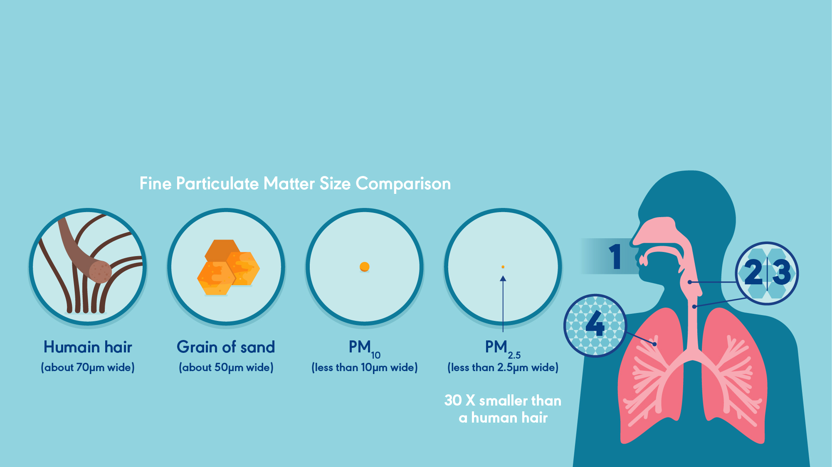
Air quality affects us.

Slide 12
Air quality affects us.

Slide 13
Professor Airianna checking in… 1 - What is the difference between weather and climate? 2 - What affects“Air Quality”? 3 - How does air quality affect us? Great! Let’s move on.

Slide 14
Read “Be Air Aware” & Watch this 1-minute video to learn about Alberta’s Airsheds
Students, let’s go ahead and:

Slide 15
So what did you learn? 1 - What is an Airshed? 2 - Do you live in an Airshed? 3 - What is AQHI? 4 – How can air pollution affect your health? Now for some hands-on learning!

Slide 16
Your turn!
Follow these steps to conduct your own scientific air quality experiment:
Choose 2 locations outdoors.
Draw with a pencil a 10 cm x 10 cm grid on the index card. At the top of the card write “Please do not disturb - experiment in progress.” Punch a hole in the corner of the card and attach a string to hang the card. Complete 2 cards the same. They should look like something like this:

Slide 17
Spread the petroleum jelly evenly over the cards. Each of the 100 squares in the grid should be covered.
Secure your cards in the chosen locations.
Record your hypothesis - which cards do they think will have the most particles on them at the end of the experiment? Why?
Keep the cards secured in place for for 2 weeks. Check your cards daily to make sure they are still in place.

Slide 18
After 2 weeks, collect the cards and make notes on your findings. Is the card a different colour? Count the number of squares that have particles on them and record. Do this for both cards. Compare the differences between each location and write down your observations.
The last step is to graph the results on a bar graph for the two locations using the following scale:
Not dirty = 0, Slightly dirty = 1-27, Dirty = 28-55,
Very dirty = 55-82, Extremely dirty = 93-110+

Slide 19
Here’s an example of what your bar chart might look like for your experiment.
You will have to decide on the scale of your chart depending on how many particles you find on your cards.

Slide 20
Share your Results!
Submit your work to Professor Airianna and be eligible for a prize!
Email your hypothesis, before and after photos of your cards, a description of your testing locations, your observations and your graph to administrator@albertaairshedscouncil.ca. Be sure to include your name and grade for Professor Airianna to respond!

Slide 21
Become a “Clean Air Champion”!
Click here to watch more short videos from the Alberta Airsheds Council and explore more of our fun and free air quality resources.
Click here to find out the AQHI in your area. Do you have friends in other areas of the Province? Connect and share your AQHI numbers!
Join others across Alberta and take the pledge to stop needless idling.
Please visit your local Airshed for more air quality information and resources.

Slide 22
Thank You!
AlbertaAirshedsCouncil.ca

Slide 23
Professor Airianna’s Answer Key
What is the difference between weather and climate?
Weather: the state of the air and atmosphere at a particular time and place. Climate: the average condition of the weather at a place over a particular time as shown by temperature, wind velocity, and precipitation (Slide 7).
What affects“Air Quality”?
Weather affects air quality, including wind, temperature, humidity, air pressure (Slide 9).
Humans affect air quality with activities such as driving, having fires, cutting grass with gas lawnmowers, heating homes and industrial activity(Slide 10).
How does air quality affect us? Air quality affects our health, including our ability to breathe. Poor air quality can irritate our respiratory tract (mouth, nose, throat and lungs). Polluted air is problematic to our heart and lungs. People with asthma are at a greater risk of increased health complications when they breathe poor quality air (Slides 11 and 12).

Slide 24
Professor Airianna’s Answer Key
What is an Airshed?
An organization that monitors local air quality by measuring air pollution and weather conditions. They report and share this data with government organizations, Indigenous communities, academics, the public, industries and other interested stakeholders.
Do you live in an Airshed?
Check on the map of the 10 regional airsheds here: https://www.albertaairshedscouncil.ca/about-airsheds. Click on the map to learn more about your local Airshed.
What is AQHI?
Air Quality Health Index is a tool designed to help you understand what the quality of the air around you means to your health. It helps you make decisions to protect your health and the environment.
How can air pollution affect your health?
It can make it hard to breathe, irritate your lungs and airways, worsen chronic conditions like heart disease and asthma and increase symptoms of pre-existing illness.

